Slide 1
ON-DEMAND DELIVERY Parcel delivery Data Analysis
JING ZHAO
2019 JAN

Slide 2


Number of Deliveries & Average delivery time
Overall we have an up trend in number of deliveries throughout the months. We have then longest average delivery time on weekends.

Slide 3
average delivery time & Number of deliveries
March
March Average Delivery Time Line Equation:
y = 0.022521x + (41.232199)
April Average Delivery Time Line Equation:
y = 0.050048x + (40.921629)
May Average Delivery Time Line Equation:
y = -0.054574x + (42.057166)
What is great is that our overall average delivery times have stayed consistent through the month of May, even with our increasing number of deliveries. The average delivery time has even decreased slightly (difficult to tell on the chart, but it is a slope of -0.05).
However, as the number of deliveries increases through the week, our average delivery times increase as well. We may not have enough couriers to react to the increased delivery needs. We will want to look into hiring more couriers, or providing a larger incentive, as the number of deliveries increases through the week so that we can decrease our average delivery times.
April
May

Slide 4

Number of Deliveries & average delivery time Over Months
From the chart above we can see that there are more deliveries on weekends than weekdays. (The weekends in each month have been highlighted in grey on the graphs.)
We can see that deliveries decrease as coming from Sunday to Monday and slowly increase from Monday to Tuesday, and gets to a small peak on Wednesday during the weekdays. It’s perhaps because that customers are more tired in the middle of the week and tend to call for a food delivery. Deliveries have peaks on Sundays because customers tend to leave their errands for Sunday or are more likely to order-in on this rest day.
In this case, we should have more people working on Wednesdays and Sundays in order to handle large number of deliveries.

Slide 5
Number of Deliveries during a day
On both weekdays and weekends, deliveries first peak at around midnight time during a day. However on the weekdays, deliveries slow down again until dinner while on the weekends, deliveries remain constant until they peak around dinner.
On both weekdays and weekends we see the most number of orders occur around midnight. We want to make sure we have enough couriers to respond to these orders during peak midnight and dinner times.

Slide 6
Delivery time outliers
General Statistics of Delivery:
mean 43.320369
std 15.876634
min 1.111192
25% 32.417293
50% 41.139020
75% 51.676998
max 370.646673
Our average delivery time for the month is around 43 minutes.
74 minutes is the minimum duration larger than median of the delivery time in the outliers. We may also want to look into any delivery that took over 74 minutes to see if there was an issue and how we may improve our delivery times.

Slide 7
Average delivery time during a day
Where we see a peak in average delivery times on the weekend we see a drop on the weekdays. More people are up later on the weekends, which probably results in more orders.
Again we may not have enough couriers at these midnight hours to respond to the number of orders being placed, which is resulting in the longer delivery times.

Slide 8
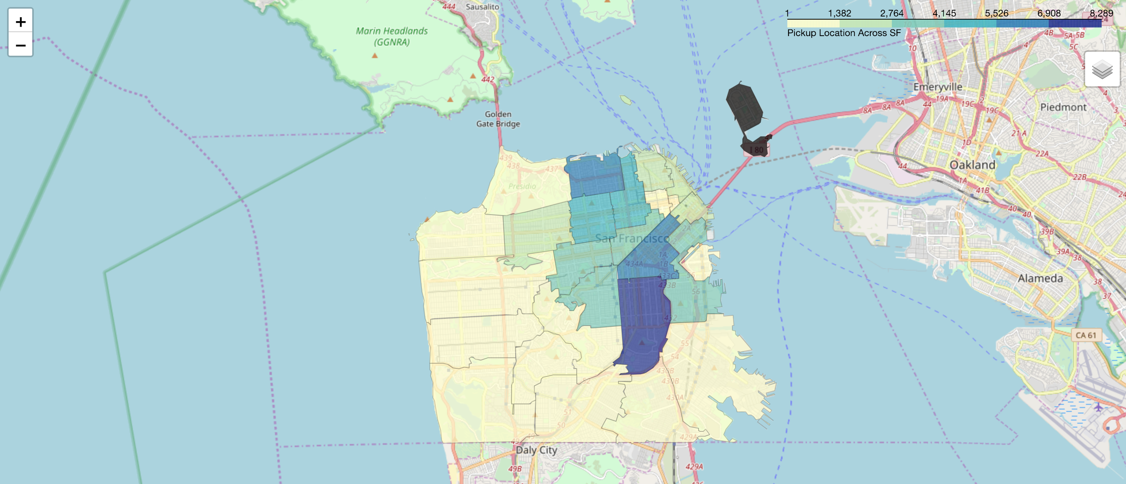
Pickup locations Across san Francisco

Slide 9
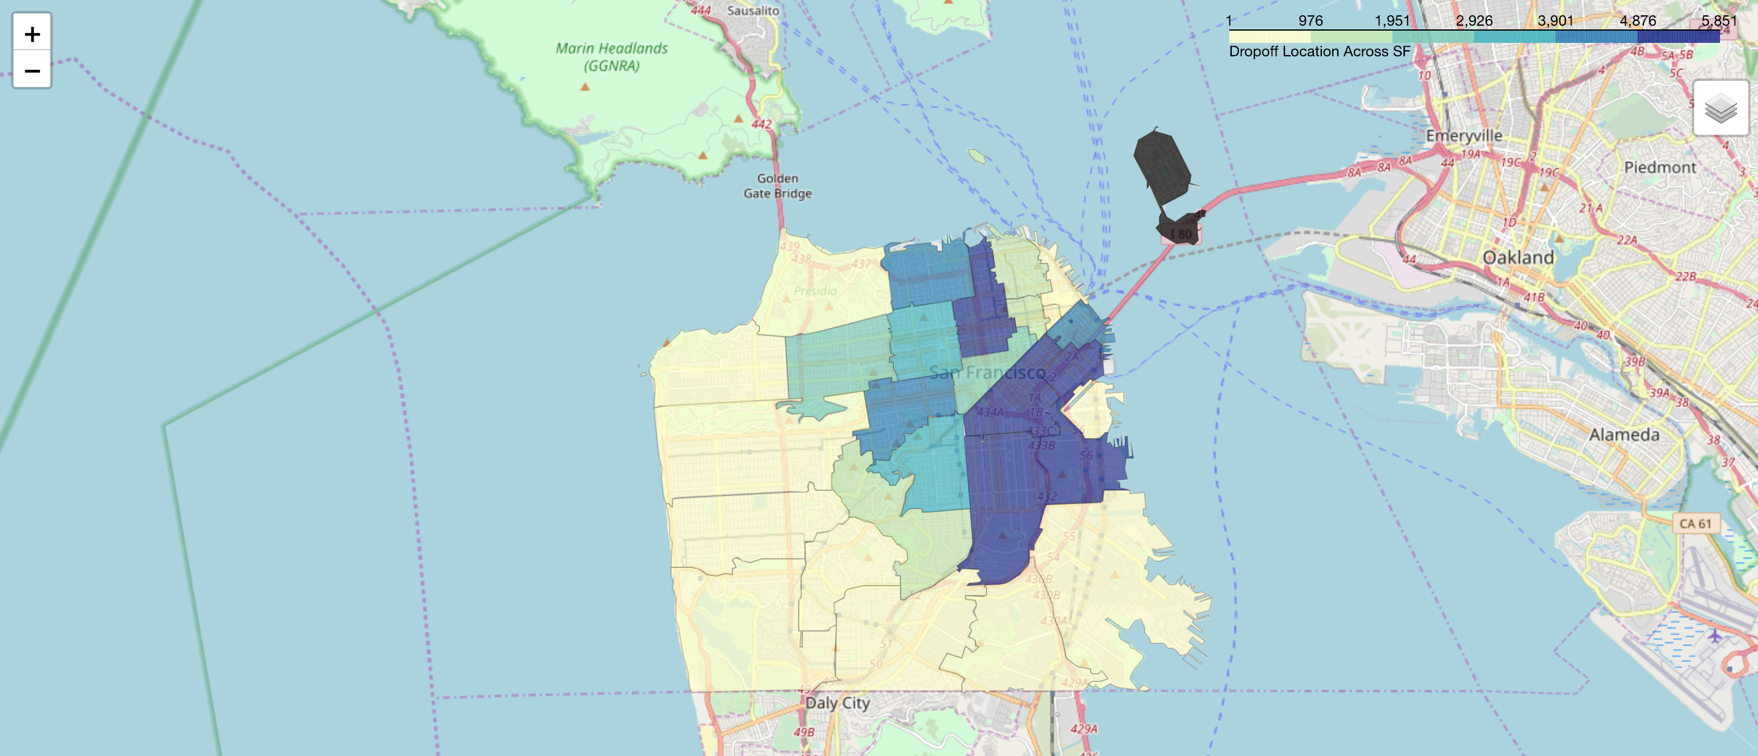
dropoff locations Across san Francisco

Slide 10
Number of pickup on each day

Slide 11
Number of dropoff on each day

Slide 12
Most popular delivery route
The most popular delivery route is pick-up at Marina and drop-off at Marina, second popular one is pick-up at Marina and drop-off at Inner Mission/Bernal Heights.
We should make sure we have more couriers delivering along these popular locations.

Slide 13
Vehicle types
From the graph we could tell the most used vehicle is bicycle, additionally bicycle has the highest average rating and shortest delivery time. It appears that bicycle is a better choice for our delivery service.
We could also make some shared bicycle spots along the most popular routes. Registered courier could use the bicycles and return them back to certain spots after delivering orders. It will shorten time for courier to pick up orders and provide convenience for them.
Most orders have viable distance which makes bicycle a viable, zero-gasoline proposition for couriers. And it can avoid traffic issues for timely delivery service.

Slide 14
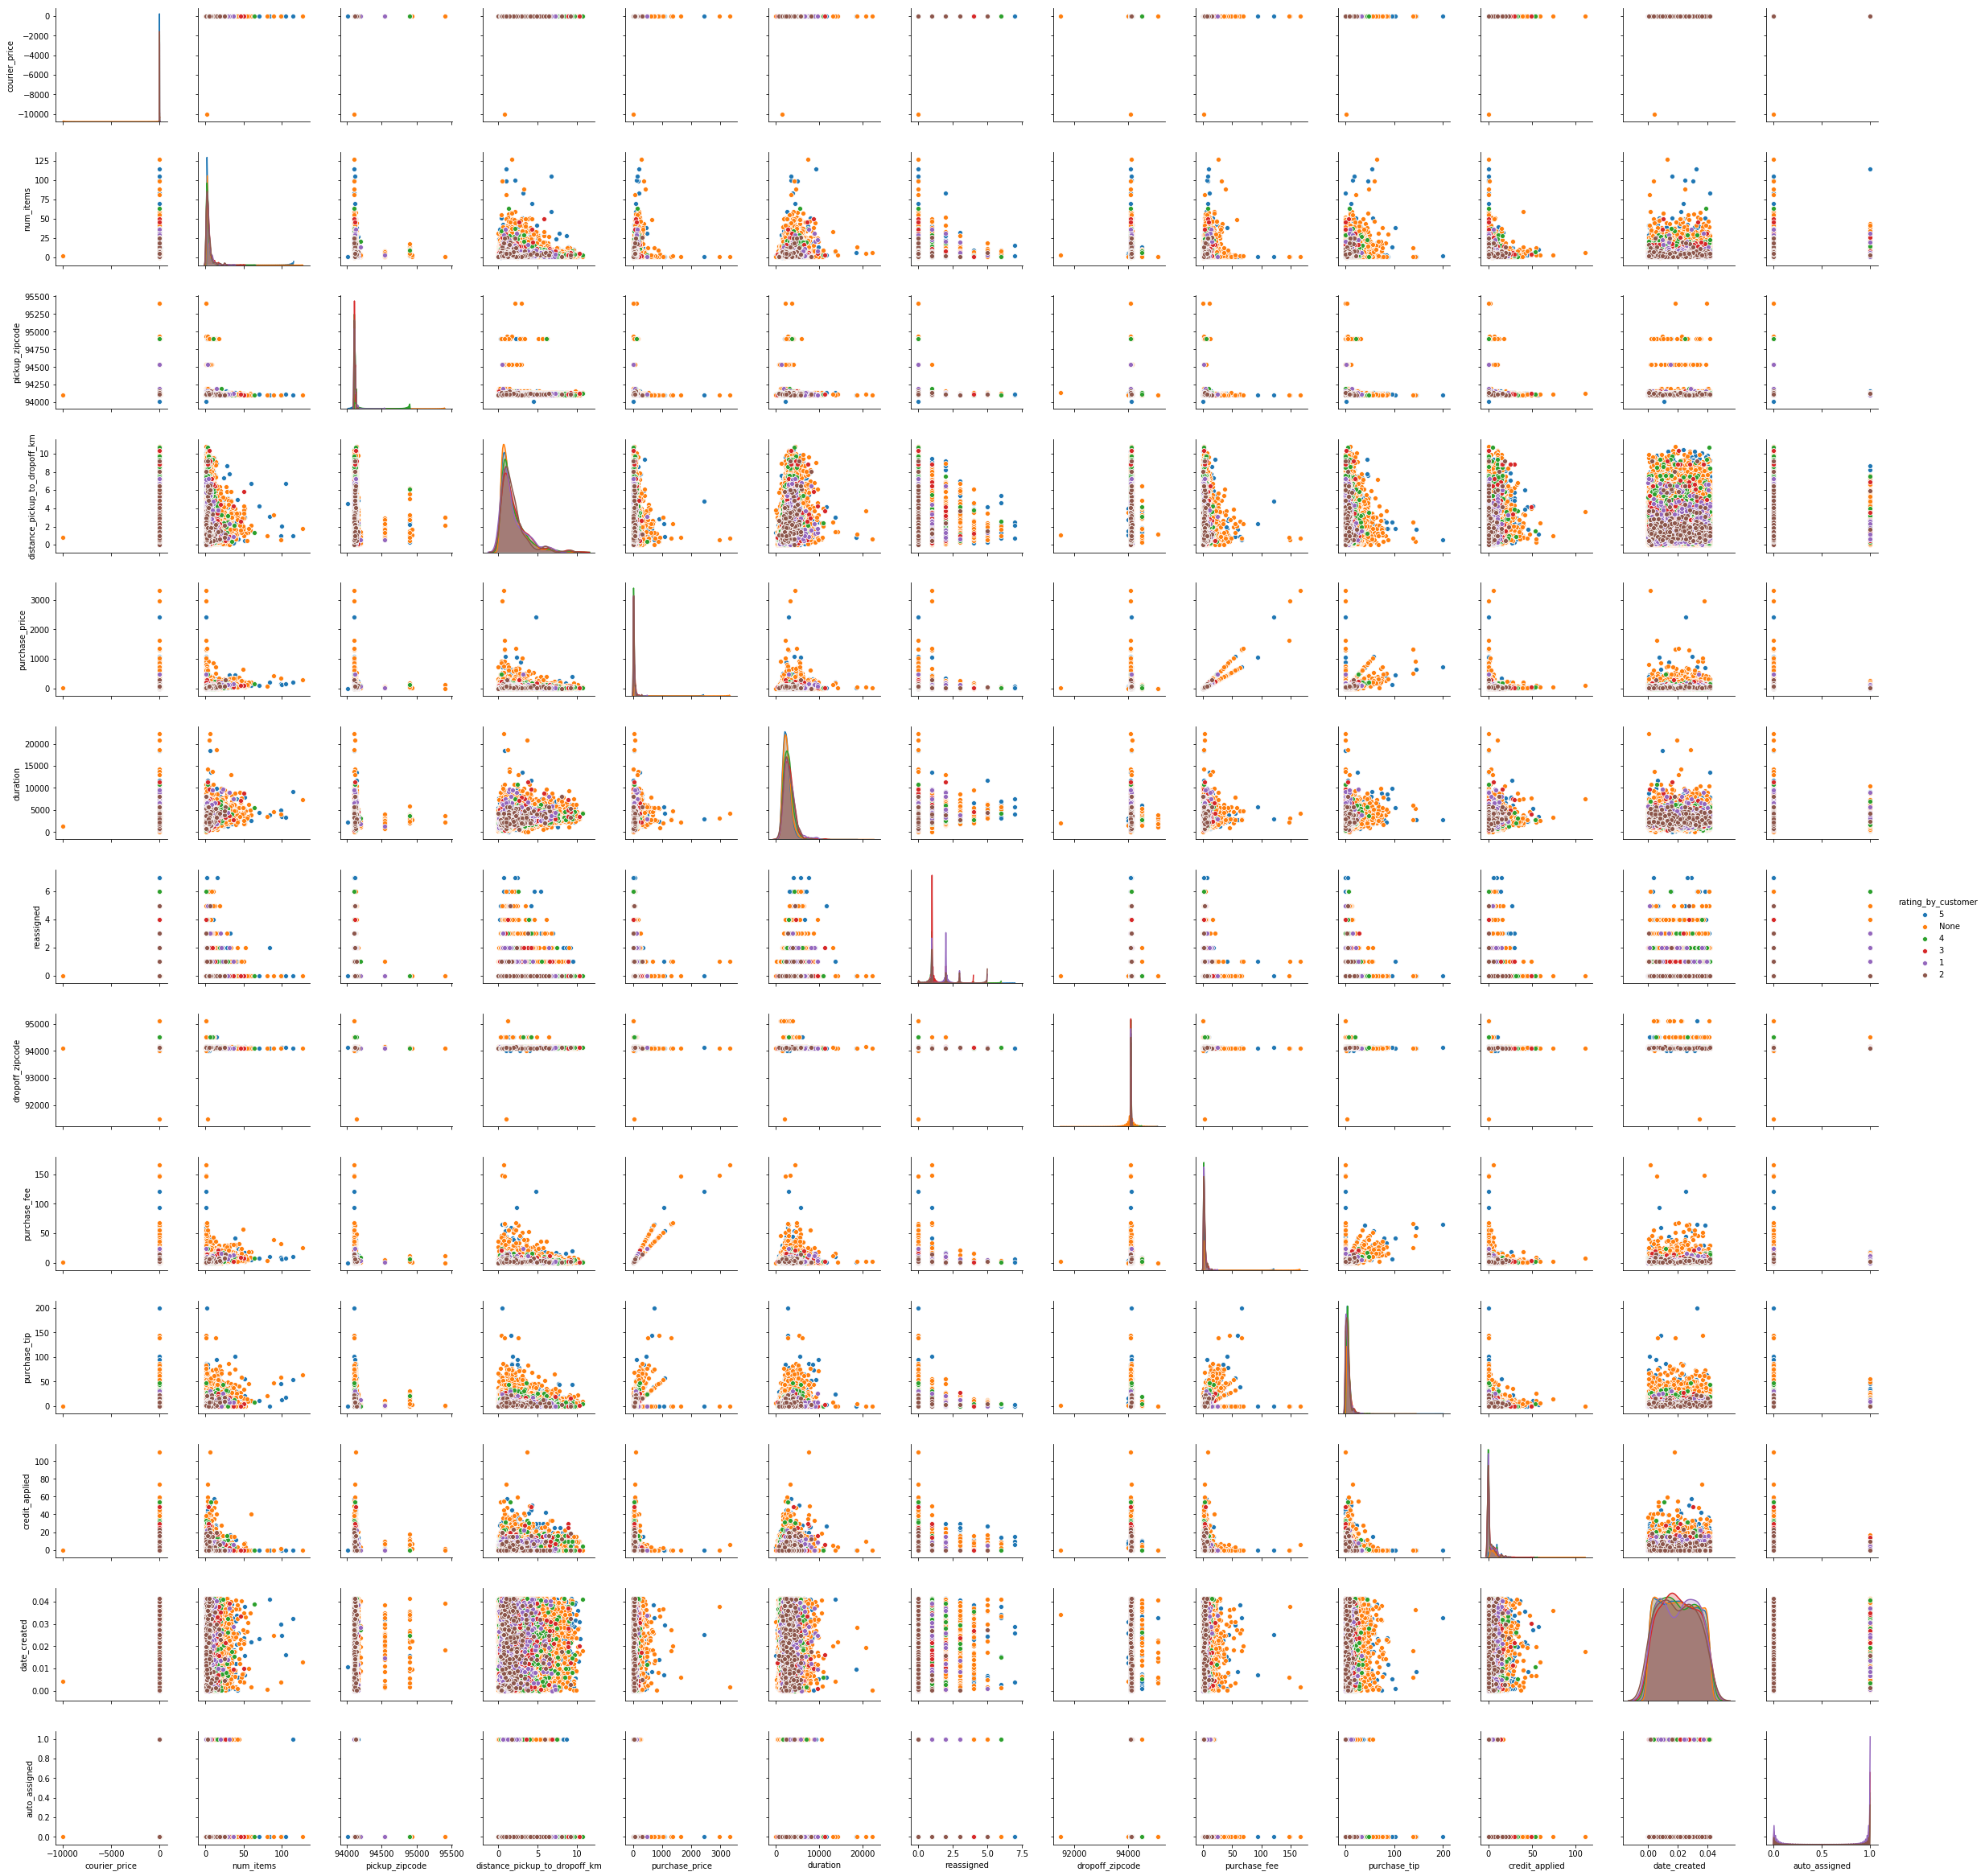
Pair plot of all metrics by customer ratings
It is important for us to keep loyal customers. And we should make every customer more satisfied with their orders.
The less duration is, the more satisfied customer is.
A rating 5 has average delivery time about 40.8 minutes while a rating 1 has average delivery time 47.4 minutes. Hence, we should make it as fast as possible and try to make it under 40 minutes for our deliveries. To achieve this goal, we could either hire more couriers by making more incentives or make it more convenient to evolve in the delivery process like using shared bicycles along most popular routes.

Slide 15
Conclusion and suggestion
We should make sufficient number of couriers work on weekends and Wednesdays in weekdays since they are the busiest days during a week. And also for the peak hours around midnight and dinner time during a day, we should make sure there are enough couriers working and responding for large amount of orders.
Loyal customers are fortune for a company. It will be better to make delivery time under 40 minutes to get higher ratings from customers. Additionally we should look into orders which take more than 74 minutes for possible reasons, so that we could provide more timely delivery in the future.
We recommend couriers to use bicycle as the vehicle for delivery. The reason is that bicycle has the shortest average delivery time, the highest average customer rating and the highest profit among all the vehicle types. In my opinion, bicycle is the most efficient vehicle for courier service since it can avoid potential traffic and parking issues and provide timely delivery service.
We could have some service spots along the most popular delivery routes. In addition, we could also provide some shared bicycles on our service spots. Every one who is interested in becoming a courier could register and use shared bicycles easily. This could be an incentive and efficient way for them to involve and hence solve the shortage problem of couriers.

